Slide 1
Session 4
Statistics and pandas…
Analytics vs data science vs inferential statistics
Descriptive stats … Lies?
Pandas – intuitive?
Explore dataset [breakout room]

Slide 2
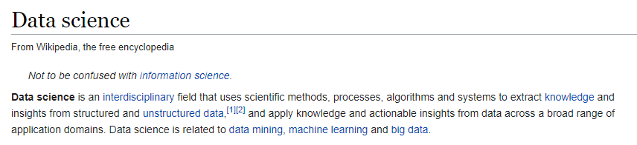
DATA SCIENCE
Statistics
Data science
Exploratory data analysis
Data analytics
What and why?
Notes:
‹#›

Slide 3
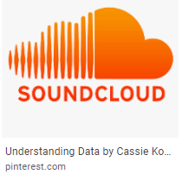
DATA SCIENCE
Make data useful

Slide 4
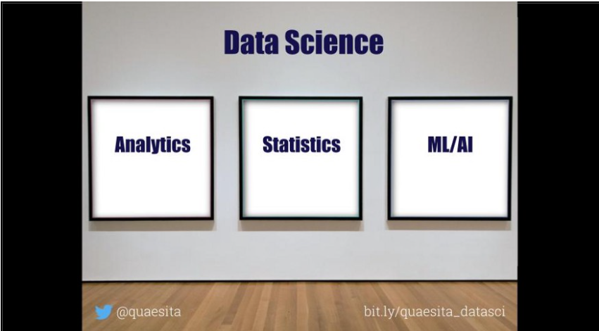
العركة؟
What’s the difference?

Slide 5
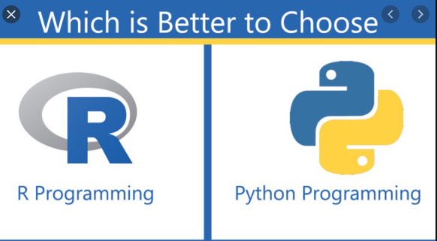

ANALYTICS VS STATS VS ML?
Notes:
The SQL vs R vs Python taxonomy is ill-advised for so many reasons, not least of which is that software evolves. (As of recently, you can even do ML in SQL.) Wouldn’t you prefer a breakdown that’ll last?
by the algorithm (surprise! it’s how university courses are structured). Pretty please, don’t taxonomize by histograms vs t-tests vs neural networks. Frankly, if you’re clever and you have a point to make, you can use the same algorithm for any part of data science. It might look like Frankenstein’s monster, but I assure you it can be forced to do your bidding.
‹#›

Slide 6
Make data useful

Slide 7
العركة؟
What’s the difference?

Slide 8



ANALYTICS VS (STATISTICS/AI/ML/DP)

Slide 9

WHAT U SEE?

Slide 10
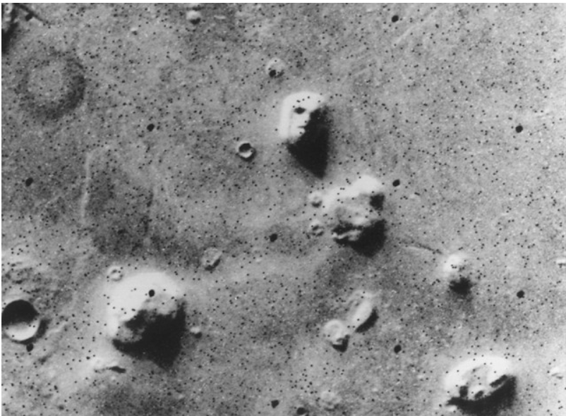

WHAT U SEE, AGAIN?
12 sec shake?
Notes:
Satellite photo of the “Face on Mars” which many people took as evidence of extraterrestrial habitation.
How to know if there is indeed life on Mars? Test
How to know if 12 sec shake of ink can give u a butterfly image?
Retry
‹#›

Slide 11
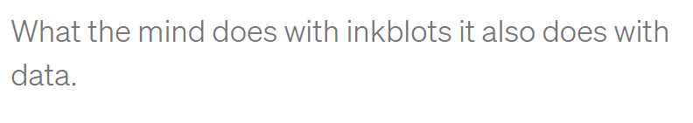
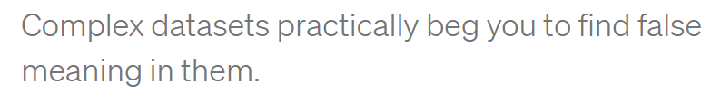

Slide 12
ANALYTICS VS (STATISTICS/AI/ML/DP)

Slide 13
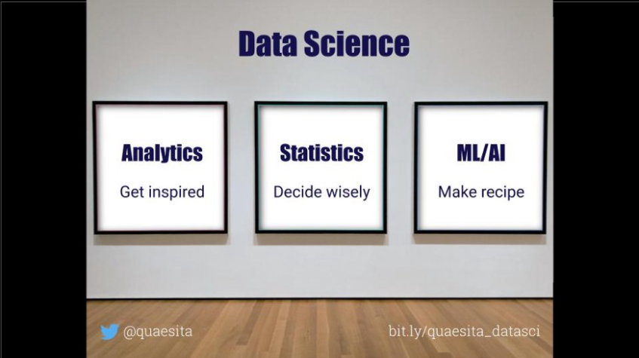

Slide 14
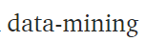
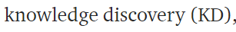
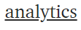
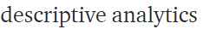
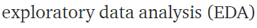
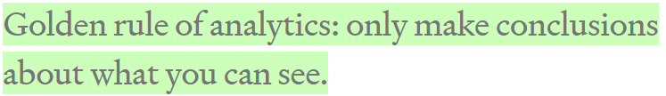
DATA ANALYTICS
Notes:
The great news is that this one is easy. Think of your dataset as a bunch of negatives you found in a darkroom. Data-mining is about working the equipment to expose all the images as quickly as possible so you can see whether there’s anything inspiring on them. As with photos, remember not to take what you see too seriously. You didn’t take the photos, so you don’t know much about what’s off-screen. The golden rule of data-mining is: stick to what is here. Only make conclusions about what you can see, never about what you can’t see (for that you need statistics and lot more expertise).
‹#›

Slide 15

WANT MORE?
Notes:
What on earth is data science?. The quest for a useful definition | by Cassie Kozyrkov | HackerNoon.com | Medium
https://medium.com/hackernoon/what-on-earth-is-data-science-eb1237d8cb37
‹#›

Slide 16
Topics in Udacity sessions
Quant vs cat
Ordinal vs nominal
Cont vs discrete
Centrality and spread
Random variable
Outliers
Desc vs inf stats

Slide 17
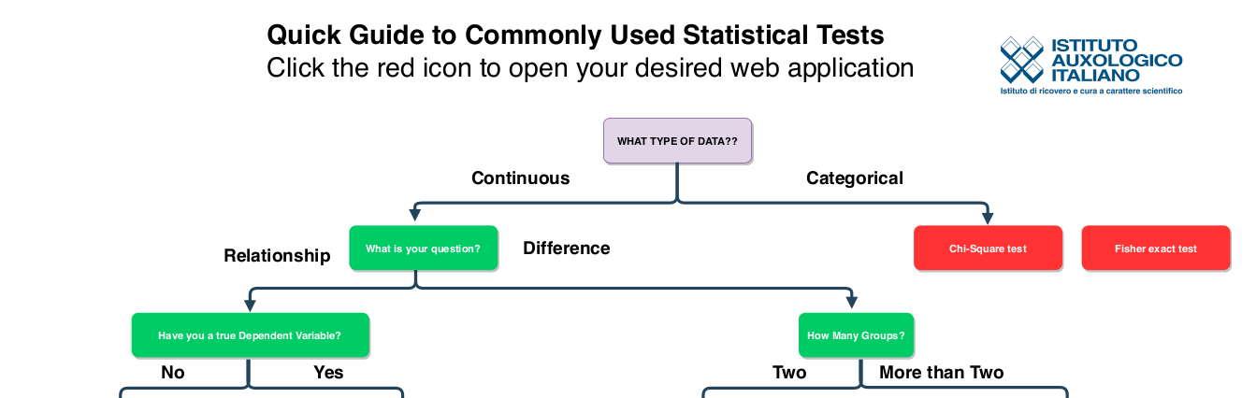
انت جاي تعمل ايه؟

Slide 18
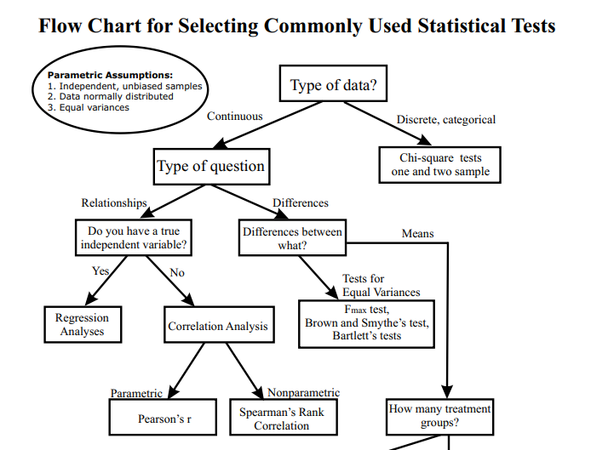

Slide 19
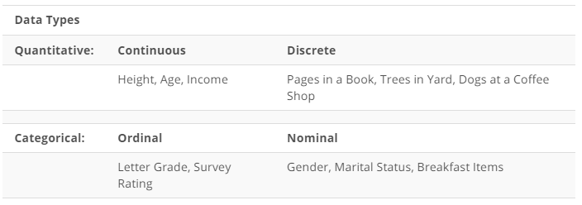
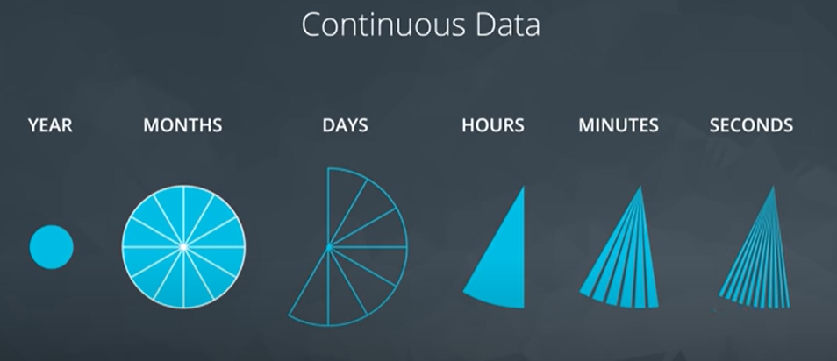
Data types

Slide 20
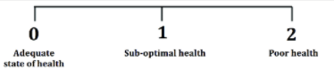
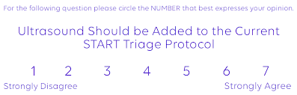
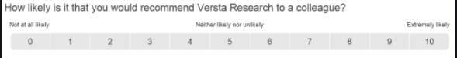
DATA TYPE
Notes:
Which can be converted to continuous ?
3 points … never
7 points … maybe
10 points .. Probably yes
‹#›

Slide 21
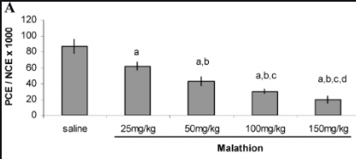
DATA TYPE
Notes:
Ordinal or nominal?
I think nominal..
But maybe if we changed saline to 0
Maybe it turns to be ordinal
‹#›

Slide 22
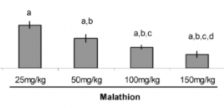
DATA TYPE
Notes:
Can be Nominal or ordinal
‹#›

Slide 23
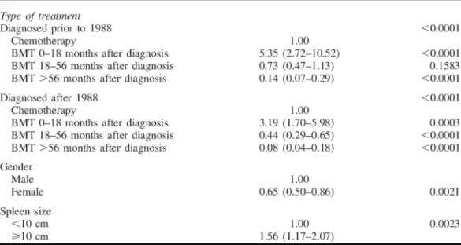
BONE MARROW TRANSPLANTATION
Notes:
Spleen size> what’s the data type
Formerly : continuous
Then categorical
Time from bmt to diagnosis
Continuous then categorical maybe ordinal
Is it outcome variable … ordinal makes sense
Is it a predictor . Maybe order matters, like Cochrane Armitage
‹#›

Slide 24
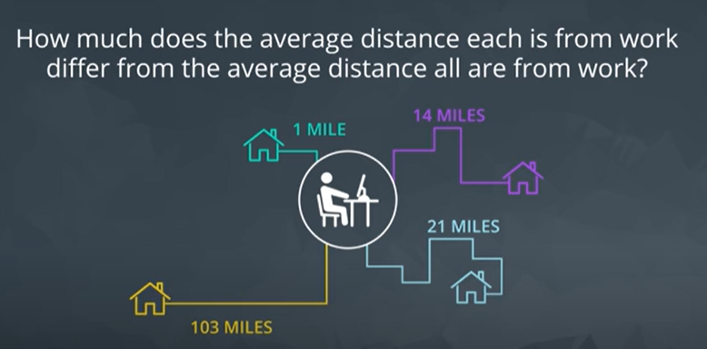
STANDARD DEVIATION
Notes:
Standard deviation
Just a single estimate for the data spread
‹#›

Slide 25
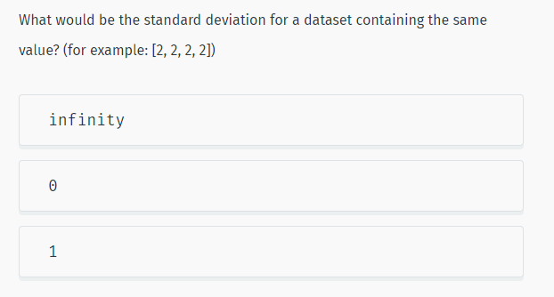
Notes:
More Statistics | SoloLearn
https://www.sololearn.com/learning/1161/4778/12271/2
‹#›

Slide 26
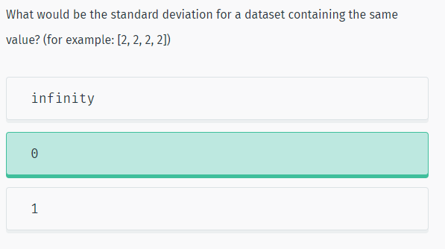
SOLUTION

Slide 27
HOW TO CHOOSE?
Range vs IQR
Mean vs median
Notes:
When to choose boxplot over histogram?
Normality : mean
Skewed : median /IQR / maybe range if no outliers
Outliers : IQR
‹#›

Slide 28
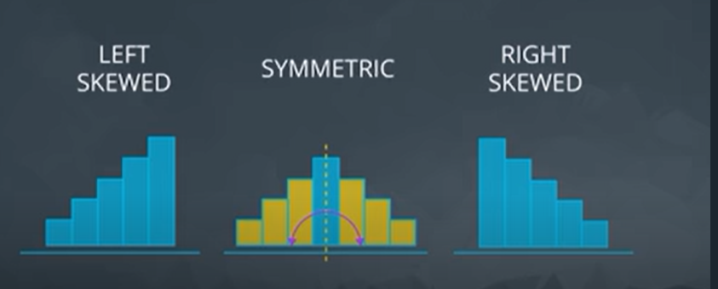
SOLUTION
Notes:
‹#›

Slide 29
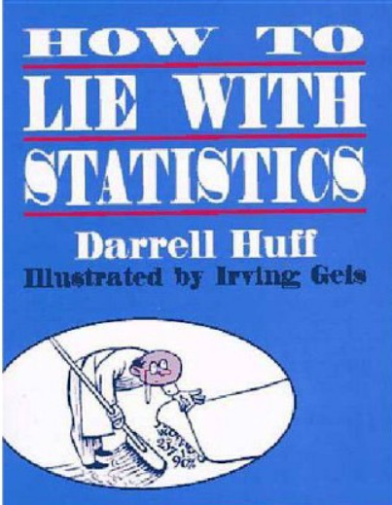
65 YEARS OLD

Slide 30


TWO HOSPITALS
100 child per day
10 child per day
Notes:
‹#›

Slide 31
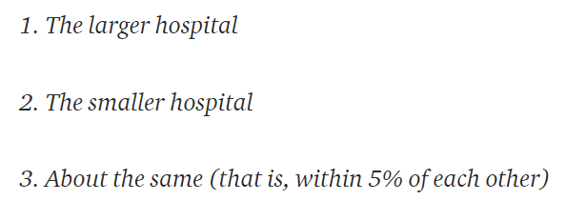
HOSPITAL WITH MORE BOYS?
For 1 year, each hospital recorded no. of days where 60% of the babies born were boys.
- Which hospital do you think recorded more such days?
Notes:
A certain town is served by two hospitals. In the larger hospital, about 45 babies are born each day, and in the smaller hospital, about 15 babies are born each day. As you know, about 50% of all babies are boys. However, the exact percentage varies from day to day. Sometimes it may be higher than 50%, sometimes lower.
For a period of 1 year, each hospital recorded the days on which more than 60% of the babies born were boys. Which hospital do you think recorded more such days?
If you guessed 2., then congratulations, you are data literate! The reasoning is the smaller the sample size, the more extreme the values.
‹#›

Slide 32

5 HEADS OUT OF 5?
Notes:
You can test the principle that small samples produce extreme results by flipping a coin. With a small sample, say 5 tosses, there is a good chance you get 4 tails. Does this mean the coin always comes up 80% tails? No, this means your sample is too small to draw any significant conclusions.
This trick is often used when marketing products by asking a small number of people about a particular brand. You can get impressive-sounding numbers (90% of doctors like this toothpaste) if you repeatedly survey small groups and only report the favorable results. Ask a small group, look at the results, throw away the bad, and repeat until you get the stats you need!
‹#›

Slide 33
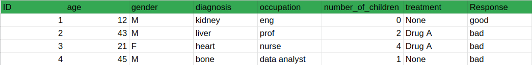
Real scenario
Complex data? Many rows many columns
Subgrouping?
Notes:
Even if data is large, one can identify useless pattern if inconsiderable subgrouping took place.
Ex. males older than 56 who are engineers and have 0 children respond to treatment
‹#›

Slide 34
CONCLUSION?
Small Samples Produce Shocking Statistics
Avoid fishing

Slide 35
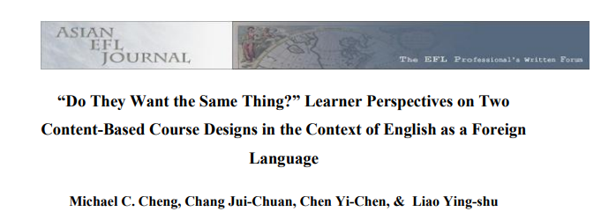
ACADEMIC PAPERS?
“over70 percent of the students preferred language-skills courses over other courses”
“of the 41 percent who planned to seek employment, an overwhelming majority of respondents (82%)disliked the idea of content-driven design (Design 1)”
Notes:
In their study on learner perspectives in the context of English as a ForeignLanguage, Cheng, Jui-Chuan, Yi-Chen and Ying-shu (2010: 79) found that “over70 percent of the students preferred language-skills courses” over other courses, which seems quite a lot. They furthermore add that “of the 41 percent who plannedto seek employment, an overwhelming majority of respondents (82%)disliked theidea of content-driven design (Design 1)” (Cheng et al. 2010: 80). The reader hasto be very diligent here and go back to the methodology section where the authorsexplain that they included only 96 participants in their study, which is“approximately 35% of the target population” (Cheng et al. 2010: 75). Hence, from274 students, a number that was not directly stated, the authors were able to ask96, which means that 35% represent the target group. From these 96 students, 41%“plan to seek employment”. This makes 39 students. 82% of these 39 students,meaning 32 students, are described as “an overwhelming majority” who “dislikedthe idea of content-driven design” (Cheng et al. 2010: 80). In the end, however,the authors only refer to 32 out of274 students. “Overwhelming” does thereforedefinitely not seem fitting. This example shows that students should be aware thatthe reference sample might be quite small and not be of importance yet still beemphasised in several studies. It should not be confused with the larger overallsample.
(11) (PDF) Statistics Can Lie! – Using Descriptive Statistics in Academic Writing to Shape Reader’s Interpretations | Jessica Dheskali - Academia.edu
https://www.academia.edu/43624921/Statistics_Can_Lie_Using_Descriptive_Statistics_in_Academic_Writing_to_Shape_Reader_s_Interpretations
‹#›

Slide 36
BACK TO METHODOLOGY SECTION
274 students
“over70 percent of the students preferred language-skills courses over other courses”
“of the 41 percent who planned to seek employment, an overwhelming majority of respondents (82%)disliked the idea of content-driven design (Design 1)”
96 participants
39 students
32 students
Notes:
In their study on learner perspectives in the context of English as a ForeignLanguage, Cheng, Jui-Chuan, Yi-Chen and Ying-shu (2010: 79) found that “over70 percent of the students preferred language-skills courses” over other courses, which seems quite a lot. They furthermore add that “of the 41 percent who plannedto seek employment, an overwhelming majority of respondents (82%)disliked theidea of content-driven design (Design 1)” (Cheng et al. 2010: 80). The reader hasto be very diligent here and go back to the methodology section where the authorsexplain that they included only 96 participants in their study, which is“approximately 35% of the target population” (Cheng et al. 2010: 75). Hence, from274 students, a number that was not directly stated, the authors were able to ask96, which means that 35% represent the target group. From these 96 students, 41%“plan to seek employment”. This makes 39 students. 82% of these 39 students,meaning 32 students, are described as “an overwhelming majority” who “dislikedthe idea of content-driven design” (Cheng et al. 2010: 80). In the end, however,the authors only refer to 32 out of274 students. “Overwhelming” does thereforedefinitely not seem fitting. This example shows that students should be aware thatthe reference sample might be quite small and not be of importance yet still beemphasised in several studies. It should not be confused with the larger overallsample.
(11) (PDF) Statistics Can Lie! – Using Descriptive Statistics in Academic Writing to Shape Reader’s Interpretations | Jessica Dheskali - Academia.edu
https://www.academia.edu/43624921/Statistics_Can_Lie_Using_Descriptive_Statistics_in_Academic_Writing_to_Shape_Reader_s_Interpretations
‹#›

Slide 37
CONCLUSION?
Small numbers again
Beware of percentages!

Slide 38



IQ TEST
Notes:
two children, one of whom tests a 99 on IQ and the other a 102, you really should not tell them to avoid comparisons. Why? Because IQ tests can have a standard error of around 3 points which means a child scoring a 99 once would be expected to score between 96 and 102 about 68% of the time. The overall difference might not be significant and could reverse itself in repeated testing. In other words, by leaving out the expected standard error in the results, you can draw a more drastic conclusion than that offered by the data.
‹#›

Slide 39

INCREASED LIFESPAN BY 2 YEARS ON AVERAGE
Notes:
Think of it this way: if there was a medicine that increased lifespan by 2 years on average would you take it? Would it change your mind if the worst impact was a loss of 12 years of life and the maximum a gain of 14 years? It usually is the details that matter and one summary statistic cannot tell the whole story.
‹#›

Slide 40
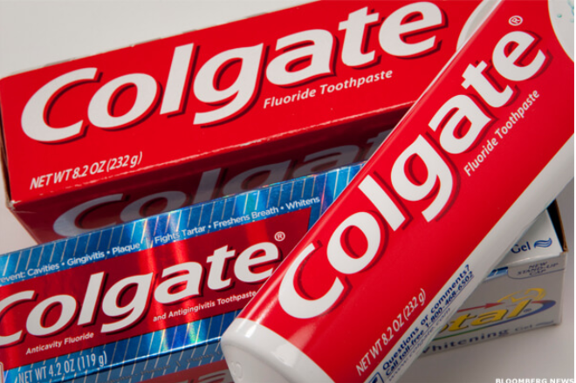
MORE THAN 80% OF DENTISTS RECOMMEND COLGATE
Notes:
Misleading Statistics & Data – News Examples For Misuse of Statistics
https://www.datapine.com/blog/misleading-statistics-and-data/
‹#›

Slide 41
MORE THAN 80% OF DENTISTS RECOMMEND COLGATE
In 2007, Colgate was ordered by the
Advertising Standards Authority (ASA)
of the U.K. to abandon their claim
Why?
Notes:
‹#›

Slide 42
THE QUESTION
Which toothpaste do u recommened? (more than 1 answer possible)
colgate
sensodyne
Miswak
…
Notes:
The claim, which was based on surveys of dentists and hygienists carried out by the manufacturer, was found to be misrepresentative as it allowed the participants to select one or more toothpaste brands. The ASA stated that the claim “… would be understood by readers to mean that 80 percent of dentists recommend Colgate over and above other brands, and the remaining 20 percent would recommend different brands.”
‹#›

Slide 43

MISLEADING
Come back ☺
Small numbers??
Notes:
The ASA continued, “Because we understood that another competitor’s brand was recommended almost as much as the Colgate brand by the dentists surveyed, we concluded that the claim misleadingly implied 80 percent of dentists recommend Colgate toothpaste in preference to all other brands.” The ASA also claimed that the scripts used for the survey informed the participants that the research was being performed by an independent research company, which was inherently false.
Maybe small numbers of surveys is also a similar problem
U survey 10 dentists. By chance u get very good results. U keep them
And remove other results that were unfavorable
‹#›

Slide 44
CONCLUSION?
Multiple answer questions …. A totally different scenario!

Slide 45
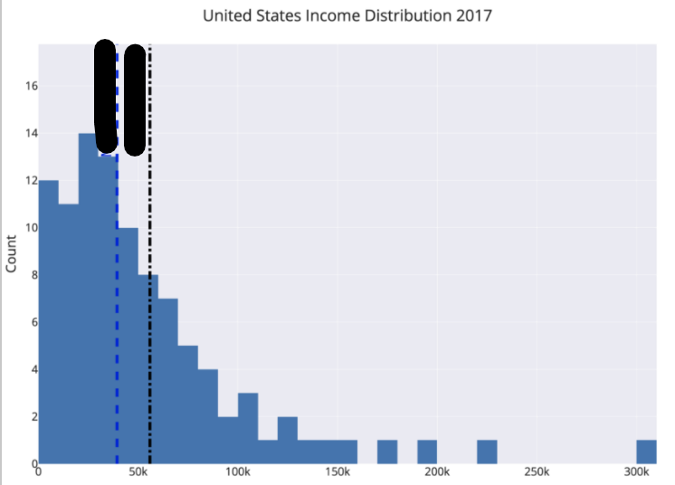
WHERE IS THE MEAN?

Slide 46
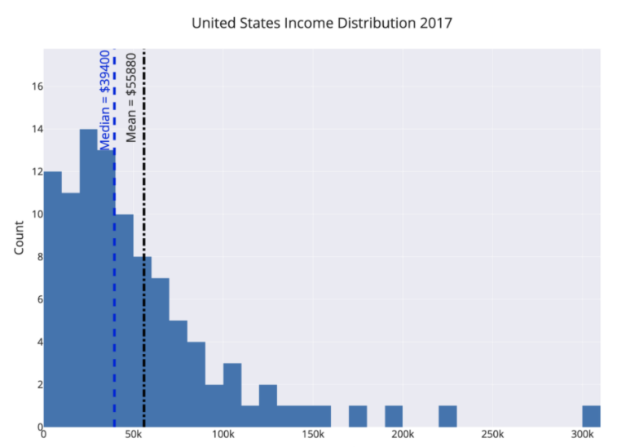
politicians, marketers,
and CEOs
Notes:
For example, the mean and median income in the United States differ by about $16,000. By choosing which value to report as the average, politicians, marketers, and CEOs can draw opposing conclusions from the same data.
How to avoid?
The way to avoid this is to look at the mean, median, and mode of a dataset (again you need all these numbers!). Figure out which one is most appropriate (usually the median for highly skewed datasets such as income, city size, life span, housing prices and so on) and use that if you need a one figure summary. If you can, graph the entire set of values in a histogram and look at the distribution. Try to use more than a single number to describe a dataset, and if you report an average, specify which you are using!
‹#›

Slide 47
90% of Drivers Consider Themselves Above Average
What u think?
Notes:
wow, other people are terrible at evaluating themselves objectively.”
Although a headline like this is often used to illustrate the illusion of superiority, (where people overestimate their competence) it also provides a useful lesson in clarifying your assertions when you talk statistics about data. In this particular case, we need to differentiate between the mean and median of a set of values. Depending on the question we ask, it is possible for 9/10 drivers to be above average.
How 90% of Drivers Can be “Above Average” or Why You Need to be Careful When Using Statistics | by Will Koehrsen | Towards Data Science
https://towardsdatascience.com/how-90-of-drivers-can-be-above-average-or-why-you-need-to-be-careful-when-talking-statistics-3df7be5cb116
‹#›

Slide 48
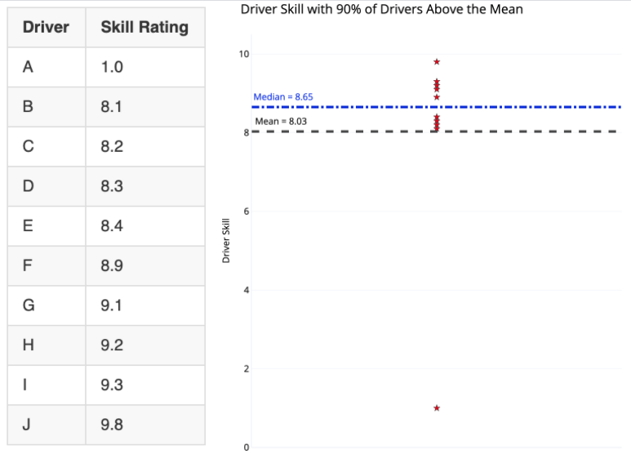
AND NOW?
What do we call this point?
Notes:
The distinction is whether we use mean or median for “average” driver skill. Using the mean, we add up all the values and divide by the number of values, giving us 8.03 for this dataset. Since 9 of the 10 drivers have a skill rating greater than this, 90% of the drivers could be considered above average!
The median, in contrast, is found by ordering the values from lowest to highest and selecting the value where half the data points are smaller and half are larger. Here it’s 8.65 with 5 drivers below and 5 above. By definition, 50% of drivers are below the median and 50% exceed the median. If the question is “do you consider yourself better than 50% of other drivers?” than 90+% of drivers cannot truthfully answer in the affirmative.
outlier
‹#›

Slide 49
MAKES SENSE?
“Majority of people live longer than average”
Notes:
An example of a negatively skewed distribution is age at death. In this dataset, there are, unfortunately, some deaths at a relatively young age, lowering the mean and skewing the graph leftward (negatively).
In the case of a negative skew, the median is greater than the mean. The result is that more people can be above the “average” when the average is defined as mean. “Majority of people live longer than average” might be a strange headline, but if you choose your stats carefully, you can make it true.
‹#›

Slide 50
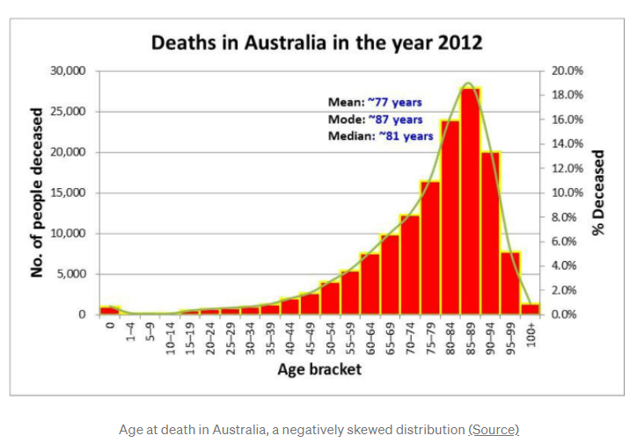
MAKES SENSE?
“Majority of people live longer than average”
Notes:
An example of a negatively skewed distribution is age at death. In this dataset, there are, unfortunately, some deaths at a relatively young age, lowering the mean and skewing the graph leftward (negatively).
In the case of a negative skew, the median is greater than the mean. The result is that more people can be above the “average” when the average is defined as mean. “Majority of people live longer than average” might be a strange headline, but if you choose your stats carefully, you can make it true.
‹#›

Slide 51
CONCLUSION?
When to use mean/median?

Slide 52

☹ ☹
289 murders in 2018
Notes:
‹#›

Slide 53
CONTEXT ☺ ☺
289 murders in 2018
2245 murders in 1990
Notes:
You can scare people by saying New York had 289 murders in 2018, but when you compare that to 2245 in 1990, you realize New York City has never been safer! It’s usually the comparison that matters; don’t let an isolated number sway your rational thinking.
‹#›

Slide 54

UNEMPLOYMENT
2019 20%
2020 13%

Slide 55

CHANGED DEFINITION
Notes:
The easiest way to lower unemployment is just to change the definition to exclude people who have stopped looking for work.
‹#›

Slide 56
CONCLUSION?
Always have a reference
Check definitions and ensure their consistency

Slide 57
DON’T PLACE TOO MUCH FAITH IN ANY ONE STATISTIC
“How to Lie with Statistics” 🡺 view any single statistic with skepticism.
Any number represents a distillation of a set of data, which was taken on a sample of a population by mistake-prone humans, using imperfect tools, in constantly changing conditions at a single point in time.
Notes:
The overall theme of “How to Lie with Statistics” is: view any single statistic with skepticism.
Any number represents a distillation of a set of data, which was taken on a sample of a population by mistake-prone humans, using imperfect tools, in constantly changing conditions at a single point in time.
‹#›

Slide 58
ENOUGH?
The data was analyzed by another human, who works for an institution, which may have outside funders with differing motivations. Finally, the statistic or graph was delivered to you by a publisher that has its own interests in getting you to believe one idea.
Notes:
All this leads to two conclusions:
If you put all your faith in one number, then you will be overfitting to the particular circumstances that produced the number.
Statistics and data are never purely objective. A statistic is one interpretation of uncertain data designed to persuade.
We should look for the range of values, report numbers with confidence intervals, gather more data before jumping to conclusions, compare multiple studies, and ask about the design of the data-gathering process
‹#›

Slide 59
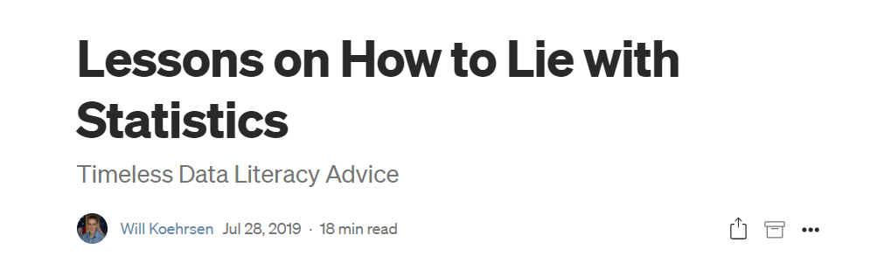
WANT TO LEARN MORE?
Notes:
Lessons on How to Lie with Statistics | by Will Koehrsen | Towards Data Science
https://towardsdatascience.com/lessons-from-how-to-lie-with-statistics-57060c0d2f19
‹#›

Slide 60
ENOUGH LIES. LET’S WORK!
How to conduct descriptive statistics?
How to make ur life easier?

Slide 61
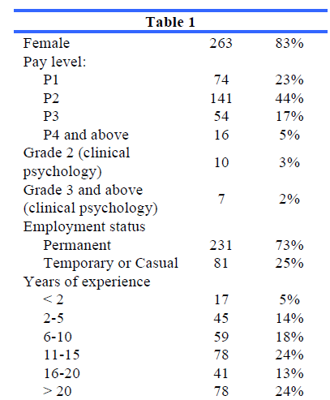
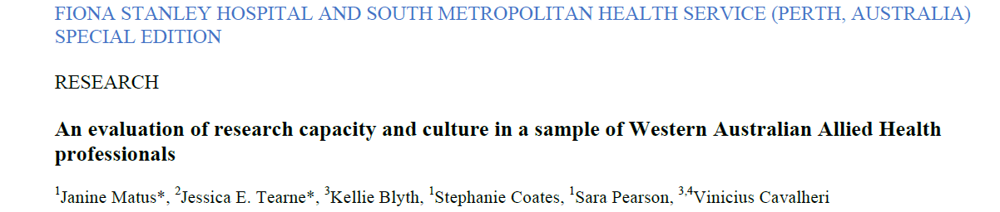
REAL LIFE

Slide 62
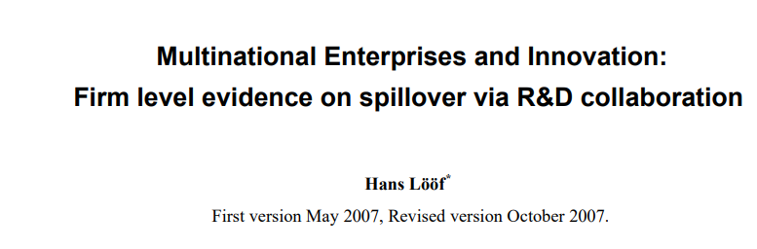
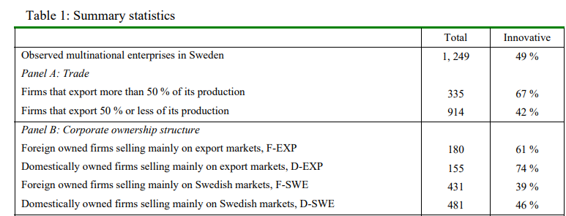
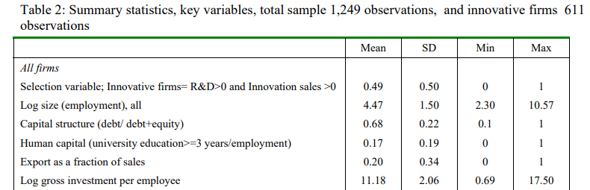
DIFFERENT SPECIALTIES

Slide 63
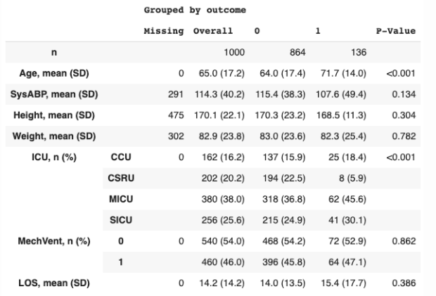
What else?
Treatment
No Yes
Can we edit the table?
Auto generation?
Notes:
Remember when we said that small sample size can make catchy observations that are not really true
P value accounts for this by taking sample size as an element in its calculation

Slide 64
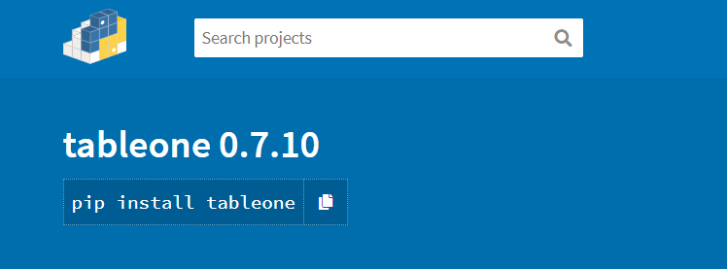
https://pypi.org/project/tableone/
Notes:
tableone · PyPI
https://pypi.org/project/tableone/
‹#›

Slide 65
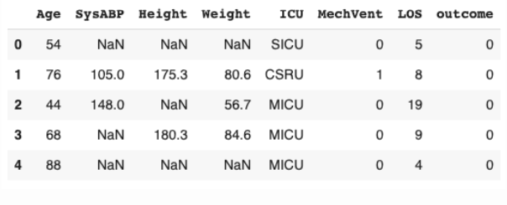

WHAT HAPPENED?
Notes:
Continuous variables : mean SD
Categorical variables : frequency percentage
Grouped by outcome
‹#›

Slide 66
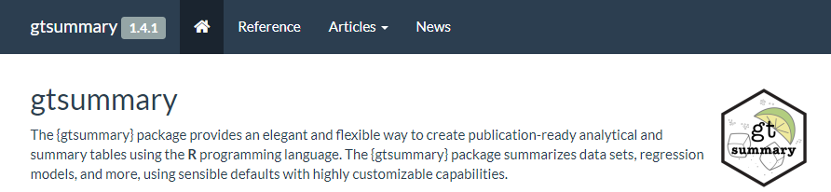
MORE FLEXIBILITY?
http://www.danieldsjoberg.com/gtsummary/
Notes:
Presentation-Ready Data Summary and Analytic Result Tables • gtsummary
http://www.danieldsjoberg.com/gtsummary/
‹#›

Slide 67


Slide 68
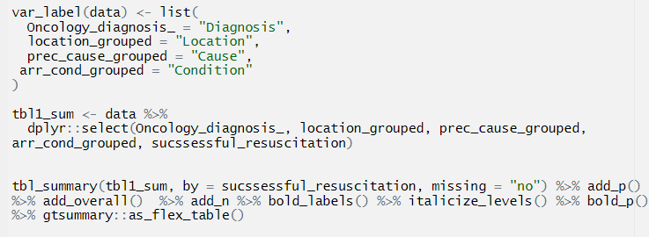
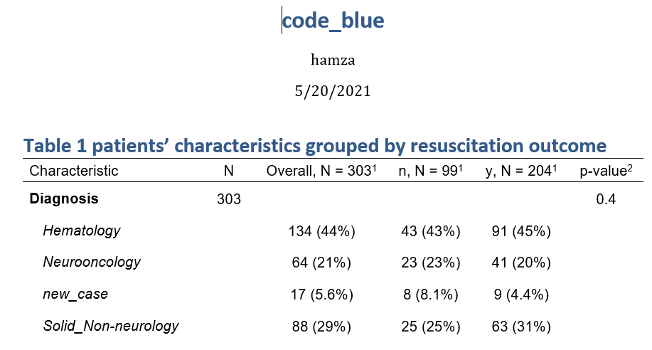
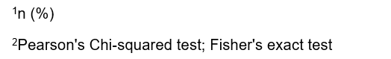

Slide 69










USEFUL NOTEBOOK EXTENSIONS
https://medium.com/@maxtingle/10-jupyter-notebook-extensions-making-my-lyfe-easier-f40139a334ce
Notes:
10 Jupyter Notebook Extensions Making My Lyfe Easier | by Max Tingle | Medium
https://medium.com/@maxtingle/10-jupyter-notebook-extensions-making-my-lyfe-easier-f40139a334ce
If you want to view the full traceback, you can click the triangle/drop-down arrow at the end of the summary to unhide the traceback.
Ever find yourself adding a bunch of cells in your notebook to test code as you debug? And do those cells just get in the way later?
Once enabled, Scratchpad is a cell that acts like a scratch notebook where you can execute code against the kernel without having to modify your notebook. Scratchpad cells are executed using “Shift+Enter” like a regular cell, and you can use the icon in the bottom-right of the screen or the keyboard shortcut “Ctrl+B” to toggle Scratchpad.
And this is where extensions really start doing the work for you. The Snippets Menu extension adds a menu item to your Jupyter Notebook where you can search for snippets, boilerplate, and examples of code to insert into your notebook.
The first time you open a notebook with initialization cells enabled, a warning will display saying the notebook is untrusted. You can choose to trust the notebook, after which the notebook will re-open in trusted mode and run your initialization cells.
Turn on the cell toolbar within your notebook menu using “View > Cell Toolbar > Initialization Cell.”
‹#›

Slide 70



Slide 71


Slide 72


Notes:
My objective is to argue that only a small subset of the library is sufficient to complete nearly all of the data analysis tasks that one will encounter.
Minimally Sufficient Pandas. In this article, I will offer an… | by Ted Petrou | Dunder Data | Medium
https://medium.com/dunder-data/minimally-sufficient-pandas-a8e67f2a2428
‹#›

Slide 73

AIM
Notes:
Know why limiting Pandas to a small subset will keep your focus on the actual data analysis and not on the syntax
Have specific guidelines for taking a single approach to completing a variety of common data analysis tasks with Pandas
‹#›

Slide 74

MINIMALLY SUFFICIENT PANDAS
Have almost everything
Analysis not syntax
Notes:
It is a small subset of the library that is sufficient to accomplish nearly everything that it has to offer.
It allows you to focus on doing data analysis and not the syntax
Your code will be simple, explicit, straightforward, and boring
You will choose one obvious way to accomplish a task
You will use this obvious way every single time
You won’t have to retain as many commands in working memory
Your code will be easier to understand by others and by you
‹#›

Slide 75


STANDARDIZING COMMON TASKS
Notes:
Better collaboration
Lesser memorization
‹#›

Slide 76


NO TRICKS
Notes:
Knowing many obscure Pandas tricks might impress your friends, but it doesn’t usually lead to good code
It can lead to long lines of code that are difficult to understand and may be harder to debug.
شوف ده وشوف ده
‹#›

Slide 77


LET’S START
Notes:
The concrete examples were all derived by the following principle:
If a method does not provide any additional functionality over another method (i.e. its functionality is a subset of another) then it shouldn’t be used. Methods should only be considered if they have some additional, unique functionality.
Will koehrson
‹#›

Slide 78

SELECTING A SINGLE COLUMN OF DATA
Select state, color, fav food
and count
NB 2
Notes:
How to select state, color favorite food and count?
Notice that when selecting count, it states at the top ‘bound method DataFrame.count of’. Python is telling us that this is a method of some DataFrame object.
Also I can’t select fav food by dot notation
Will cover isA
‹#›

Slide 79

THE COLUMN NAME IS A VARIABLE
Notes:
Failure
‹#›

Slide 80

AUTOCOMPLETION?

Slide 81


Notes:
Which AI Code Autocomplete Should You Choose? | The Startup
https://medium.com/swlh/kite-vs-tabnine-which-ai-code-autocomplete-should-you-choose-eb6eba85c3a6#:~:text=TabNine%20was%20released%20in%202019,Atom%2C%20Sublime%20Text%2C%20etc.
‹#›

Slide 82

Github copilot

Slide 83

HOW TO SELECT ROWS AND COLUMNS?
ix
loc
iloc
at
Iat

Slide 84


IX INDEXER
Why was it deprecated?
Notes:
The ix indexer was created in the early days of Pandas to select rows and columns by both label and integer location.
This turned out to be quite ambiguous as Pandas row and column names can be both integers and strings.
‹#›

Slide 85
SOLUTION?
loc 🡺 label
iloc 🡺 integer location
Notes:
Deprecated : مهملة
Move to jupyter
‹#›

Slide 86
HOW TO SELECT ROWS AND COLUMNS?
ix
loc
iloc
at
iat

Slide 87

SELECTION WITH AT AND IAT
Only a single cell
Notes:
select a single cell of a DataFrame
These provide a slight performance advantage over their analogous loc and ilocindexers. But, they introduce the additional burden of having to remember what they do. Also, for most data analyses, the increase in performance isn’t useful unless it’s being done at scale. And if performance truly is an issue, then taking your data out of a DataFrame and into a NumPy array will give you a large performance gain.
‹#›

Slide 88
HOW TO SELECT ROWS AND COLUMNS?
ix
loc
iloc
at
Iat
Notes:
The documentation uses the term position for referring to integer location. I do not like this terminology as I feel it is confusing. Integer location is more descriptive and is exactly what .iloc stands for.
python - pandas loc vs. iloc vs. at vs. iat? - Stack Overflow
https://stackoverflow.com/questions/28757389/pandas-loc-vs-iloc-vs-at-vs-iat
A perfect ans by Ankit Agrawal
‹#›

Slide 89
METHOD DUPLICATION
Which one to choose?
Notes:
The isna method was added more recently because the characters na are found in other missing value methods such as dropna and fillna. Confusingly, Pandas uses NaN, None, and NaT as missing value representations and not NA.
‹#›

Slide 90

METHOD DUPLICATION
Which one to choose?
Do we need notna?
Notes:
The isna method was added more recently because the characters na are found in other missing value methods such as dropna and fillna. Confusingly, Pandas uses NaN, None, and NaT as missing value representations and not NA.
There are aliases. Choose whichever u like
‹#›

Slide 91

SOLUTION
Notes:
You can also avoid ever using notna since Pandas provides the inversion operator, ~ to invert boolean DataFrames.
‹#›

Slide 92



BUILTIN PYTHON VS PANDAS
Which one
To use?
NB 4
Notes:
‹#›

Slide 93

TWO DATASETS?
CONCAT
APPEND
JOIN
MERGE
Notes:
‹#›

Slide 94

TWO DATASETS

Slide 95

SQL?
NB Combining dataframes
Notes:
‹#›

Slide 96


IGNORE INDEX
What to expect?
Notes:
‹#›

Slide 97


SOLUTION
Notes:
‹#›

Slide 98

HOW TO GROUP AND AGGREGATE?
SAT verbal
undergrad population per state
state abbreviation
SAT math
Notes:
finding the maximum SAT score per state
‹#›

Slide 99



GUIDANCE

Slide 100

MULTIINDEX
How to?
How to remove?
Notes:
Relaffil = rel affiliation
A MultiIndex or multi-level index is a cumbersome addition to a Pandas DataFrame that occasionally makes data easier to view, but often makes it more difficult to manipulate. You usually encounter a MultiIndex after a call togroupby when using multiple grouping columns or multiple aggregating columns.
Here Both the rows and columns have a MultiIndex with two levels.
They have different syntax for making subset selections and are more difficult to use with other methods. If you are an expert Pandas user, you can get some performance gains when making subset selections,
‹#›

Slide 101


ANY DIFFERENCE?
Modify to
Get the
multiindex

Slide 102

SOLUTION
How to revert
multilevel index?

Slide 103




RENAME AND RESET
Rename columns
Reset index
Notes:
Guidance: Avoid using a MultiIndex. Flatten it after a call to groupby by renaming columns and resetting the index.
‹#›

Slide 104

GROUPBY VS PIVOT_TABLE VS CROSSTAB VS PIVOT

Slide 105



WHICH IS WHICH?
Wide vs
Long?
When to use?
Notes:
Groupby vs pivot_table
The wide format is the pivot table
Guidance: use pivot_table when comparing groups
I really like to use pivot tables to compare values across groups and a groupby when I want to continue an analysis. From above, it is easier to compare male to female salaries when using the output of pivot_table. The result is easier to digest as a human and its the type of data you will see in an article or blog post. I view pivot tables as a finished product.
The result of a groupby is going to be in tidy form, which lends itself to easier subsequent analysis, but isn’t as interpretable
‹#›

Slide 106

TIDY
Notes:
Tidy Data | Wickham | Journal of Statistical Software
https://www.jstatsoft.org/article/view/v059i10
‹#›

Slide 107

SIMILAR?

Slide 108


PIVOT_TABLE VS PD.CROSSTAB
Notes:
The pivot_table method and the crosstab function can both produce the exact same results with the same shape. They both share the parameters index, columns, values, and aggfunc. The major difference on the surface is that crosstab is a function and not a DataFrame method.
‹#›

Slide 109

HOW TO GET WITH PIVOT_TABLE?

Slide 110

HOW TO GET WITH PIVOT_TABLE?
What about cross_tab?
Notes:
‹#›

Slide 111

WITH CROSS_TAB

Slide 112

WANT RELATIVE FREQUENCY?

Slide 113

PRETTY EASY
Notes:
You also have the option of normalizing over the rows using the string ‘index’ or over the entire DataFrame with the string ‘all’ as seen below.
‹#›

Slide 114

NORMALIZING OVER ROWS OR DF
Notes:
You also have the option of normalizing over the rows using the string ‘index’ or over the entire DataFrame with the string ‘all’ as seen below.
‹#›

Slide 115
BOTTOM LINE
Cross_tab easier for frequency
It seems that it can do everything
I think I can recommend it over pivot_table

Slide 116

PIVOT VS PIVOT_TABLE

Slide 117

NO AGGREGATION
Notes:
Using the pivot method, reshapes the data without aggregating or doing anything to it. pivot_table, on the other hand, requires that you do an aggregation
‹#›

Slide 118


PIVOT PITFALLS
Notes:
it can only handle the case when both index and columns are set to a single column. If you want to keep multiple columns in the index then you cannot use pivot. Also, if any combination of index and columns appear more than once, then you will get an error as it does not perform an aggregation.
pivot_table can accomplish all of what pivot can do. In the case that you do not need to perform an aggregation, you still must provide an aggregation function.
I think cross_tab is a better alternative
‹#›

Slide 119


MELT VS STACK
How to reshape?
Notes:
Let’s reshape this data so that we have three columns, the airline, the airport and the arrival delay
‹#›

Slide 120
USING MELT
What about stack??
Notes:
Let’s reshape this data so that we have three columns, the airline, the airport and the arrival delay
‹#›

Slide 121



USING STACK
Set index
Use stack

Slide 122
COMPARE MELT/STACK OUTPUT
melt
stack
How to revert multi-index?
Notes:
This returns a Series with a MultiIndex with two levels.
‹#›

Slide 123



Slide 124



MELT ADVANTAGE
Notes:
Renaming on the fly
‹#›

Slide 125
DO WE NEED APPLY?
Consider discussing this
But after reading more about `
Notes:
Also see this Perfect post on stackoverflow
python - When should I (not) want to use pandas apply() in my code? - Stack Overflow
https://stackoverflow.com/questions/54432583/when-should-i-not-want-to-use-pandas-apply-in-my-code#:~:text=It%20is%20because%20apply%20is,major%20overhead%20at%20each%20iteration.
How and why to stop using pandas .apply() (so much) | by Sven Harris | Towards Data Science
https://towardsdatascience.com/avoiding-apply-ing-yourself-in-pandas-a6ade4569b7f
‹#›

Slide 126

APPLY VS MAP VS APPLYMAP
Notes:
Introduction to Pandas apply, applymap and map | by B. Chen | Towards Data Science
https://towardsdatascience.com/introduction-to-pandas-apply-applymap-and-map-5d3e044e93ff
‹#›

Slide 127



APPLY
Can we use lambda?

Slide 128

APPLY

Slide 129


APPLY
Can we use lambda?
Notes:
‹#›

Slide 130

APPLY

Slide 131

Notes:
applymap() is only available in DataFrame and used for element-wise operation across the whole DataFrame. It has been optimized and some cases work much faster than apply() , but it’s good to compare it with apply() before going for any heavier operation.
‹#›

Slide 132



Slide 133

MAP

Slide 134



MAP
Notes:
map() is only available in Series and used for substituting each value in a Series with another value. To understand how the map() works, we first create a Series.
map() accepts a dict or a Series. Values that are not found in the dict are converted to NaN, unless the dict has a default value (e.g. defaultdict):
‹#›

Slide 135

Notes:
To avoid applying the function to missing values (and keep them as NaN) na_action='ignore' can be used:
‹#›

Slide 136












BEST OF THE API
Notes:
‹#›

Slide 137

RUN ALL CELLS?

Slide 138
SIMPSON’S PARADOX REVISITED?

Slide 139
HOW TO GROUP AND AGGREGATE?
Notes:
finding the maximum SAT score per state
‹#›

Slide 140
GUIDANCE

Slide 141
MULTIINDEX
How to?
How to remove?
Notes:
Relaffil = rel affiliation
A MultiIndex or multi-level index is a cumbersome addition to a Pandas DataFrame that occasionally makes data easier to view, but often makes it more difficult to manipulate. You usually encounter a MultiIndex after a call togroupby when using multiple grouping columns or multiple aggregating columns.
Here Both the rows and columns have a MultiIndex with two levels.
They have different syntax for making subset selections and are more difficult to use with other methods. If you are an expert Pandas user, you can get some performance gains when making subset selections,
‹#›

Slide 142
ANY DIFFERENCE?
Modify to
Get the
multiindex

Slide 143
SOLUTION
How to revert
multilevel index?

Slide 144
RENAME AND RESET
Rename columns
Reset index
Notes:
Guidance: Avoid using a MultiIndex. Flatten it after a call to groupby by renaming columns and resetting the index.
‹#›

Slide 145
GROUPBY VS PIVOT_TABLE VS CROSSTAB VS PIVOT

Slide 146
WHICH IS WHICH?
Wide vs
Long?
When to use?
Notes:
Groupby vs pivot_table
The wide format is the pivot table
Guidance: use pivot_table when comparing groups
I really like to use pivot tables to compare values across groups and a groupby when I want to continue an analysis. From above, it is easier to compare male to female salaries when using the output of pivot_table. The result is easier to digest as a human and its the type of data you will see in an article or blog post. I view pivot tables as a finished product.
The result of a groupby is going to be in tidy form, which lends itself to easier subsequent analysis, but isn’t as interpretable
‹#›

Slide 147
TIDY
Notes:
Tidy Data | Wickham | Journal of Statistical Software
https://www.jstatsoft.org/article/view/v059i10
‹#›

Slide 148
SIMILAR?

Slide 149
PIVOT_TABLE VS PD.CROSSTAB
Notes:
The pivot_table method and the crosstab function can both produce the exact same results with the same shape. They both share the parameters index, columns, values, and aggfunc. The major difference on the surface is that crosstab is a function and not a DataFrame method.
‹#›

Slide 150
WANT RELATIVE FREQUENCY?

Slide 151
PRETTY EASY
Notes:
You also have the option of normalizing over the rows using the string ‘index’ or over the entire DataFrame with the string ‘all’ as seen below.
‹#›

Slide 152
NORMALIZING OVER ROWS OR DF
Notes:
You also have the option of normalizing over the rows using the string ‘index’ or over the entire DataFrame with the string ‘all’ as seen below.
‹#›

Slide 153
PIVOT VS PIVOT_TABLE

Slide 154


SETTING THE SCENE
Notes:
d represents the weighted average of 50 Indian company stocks in 17 sectors. The dataset is openly available on Kaggle, but we’ll be using a subset of the data containing the stock value of only four sectors – banking, pharma, IT, and FMCG.
‹#›

Slide 155



WHAT TO EXPECT?
Notes:
Where is the x?
‹#›

Slide 157

SOLUTION
Notes:
Where is the x?
You will also need to specify the x and y coordinates to be referenced as the x and y-axis. Since the Date is already the index column, it will be configured as the X-axis.
‹#›

Slide 158

OTHER OPTIONS?
https://pandas.pydata.org/pandas-docs/stable/reference/api/pandas.DataFrame.plot.html

Slide 159


Slide 160

BAR PLOTS
Can we use a bar plot?

Slide 161

SOLUTION: GROUP/AGGREGATE
Can we draw bar charts for all 4 columns?
Notes:
data.resample() is used to resample the stock data.
The ‘M’ stands for month-end frequency and denotes the offset values you want to resample the data.
mean() indicates the average stock price during this period.
Is the average per month or the last day only?
‹#›

Slide 162

How to convert to bar.. Multiple bars?
Notes:
‹#›

Slide 163

SOLUTION
Notes:
‹#›

Slide 164

SIMILAR SOLUTION
Notes:
‹#›

Slide 165

HOW TO GET THIS?

Slide 166

SOLUTION

Slide 167


STACKED?

Slide 168

WHAT ABOUT HORIZONTAL STACKED?

Slide 169
CORRECT ☺

Slide 170

HISTOGRAMS VS BAR PLOTS?
Any differences?
Notes:
‹#›

Slide 171

Number of Axes needed?
Sure for bar graph?
Notes:
1 for hist
2 for bar
What about count plot?
‹#›

Slide 172


COUNTPLOT
http://seaborn.pydata.org/examples/index.html
Also check their tutorial tab
Notes:
‹#›

Slide 173

HISTOGRAM OR BAR PLOT?

Slide 174
HISTOGRAM OR BAR PLOT?
What does the code mean?
Notes:
The default bin value is 10. Bin size can be changed using the “bins” keyword.
Alpha sets the transparence
We selected only two columns
‹#›

Slide 175

WHAT TO CHOOSE?

Slide 176
WHAT TO CHOOSE?
Notes:
‹#›

Slide 177

OTHER OPTIONS
Notes:
A hexagonal bin plot, also known as a hexbin plot, can be used as an alternative to scatterplots. This kind of plot is particularly useful when the number of data points is huge, and each point cannot be plotted individually.
‹#›

Slide 178

https://neptune.ai/blog/pandas-plot-deep-dive-into-plotting-directly-with-pandas?utm_source=datacamp&utm_medium=post&utm_campaign=blog-pandas-plot-deep-dive-into-plotting-directly-with-pandas
Notes:
Pandas objects come equipped with their plotting functions. These plotting functions are essentially wrappers around the matplotlib library. Think of matplotlib as a backend for pandas plots.
5 Minute Guide to Plotting with Pandas | by Rebecca Vickery | Towards Data Science
https://towardsdatascience.com/5-minute-guide-to-plotting-with-pandas-e8c0f40a1df4
Fast plotting with Pandas. Quickly visualize your data with these… | by Tom Waterman | Towards Data Science
https://towardsdatascience.com/the-best-pandas-plotting-features-c9789e04a5a0
Data Visualization with Pandas and Seaborn 🎓 | by Tirendaz Academy | Level Up Coding
https://levelup.gitconnected.com/data-visualization-with-pandas-and-seaborn-5de444b567a0
08.Pandas Visualization | jupyter notebooks gallery
https://notebook.community/vravishankar/Jupyter-Books/pandas/08.Pandas%20Visualization
Python for Librarians: Plotting Your Data - Pandas
https://librarycarpentry.org/library-python/06a-plotting-with-pandas/
5.0
https://phdphysics.cloud.ba.infn.it/wp-content/uploads/2017/06/8-Diacono-3Maggio.pdf
Univariate plots in pandas | Python
https://campus.datacamp.com/courses/python-for-r-users/plotting-4?ex=2
Pandas Foundations | DataCamp
https://learn.datacamp.com/courses/pandas-foundations?tap_a=5644-dce66f&tap_s=93618-a68c98
Data Science Courses: R & Python Analysis Tutorials | DataCamp
https://learn.datacamp.com/search?q=pandas+plot
Pandas Plot: Deep Dive Into Plotting Directly with Pandas - neptune.ai
https://neptune.ai/blog/pandas-plot-deep-dive-into-plotting-directly-with-pandas?utm_source=datacamp&utm_medium=post&utm_campaign=blog-pandas-plot-deep-dive-into-plotting-directly-with-pandas
‹#›

Slide 179
Breakout rooms
A1 (demo). Pandas and UCI adult dataset | Kaggle
https://www.kaggle.com/code/kashnitsky/a1-demo-pandas-and-uci-adult-dataset
A1 (demo). Pandas and UCI adult dataset. Solution | Kaggle
https://www.kaggle.com/code/kashnitsky/a1-demo-pandas-and-uci-adult-dataset-solution/notebook

